Slide 1



World GDP to Happy Score
View in Power BI
Last data refresh:
30/12/2021 03:49:51 UTC
Downloaded at:
30/12/2021 04:11:15 UTC

Slide 2
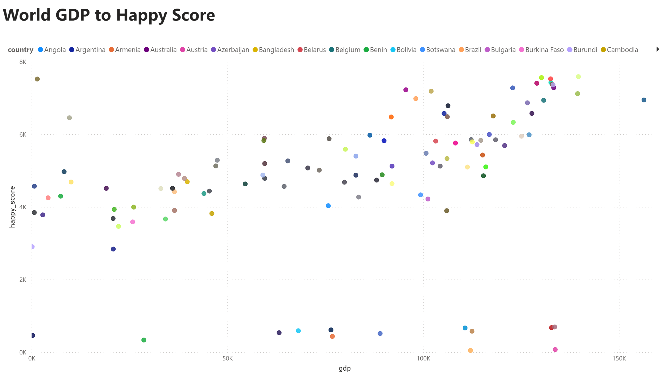
Sebaran
Notes:
scatterChart
No alt text provided
textbox
No alt text provided

Slide 3
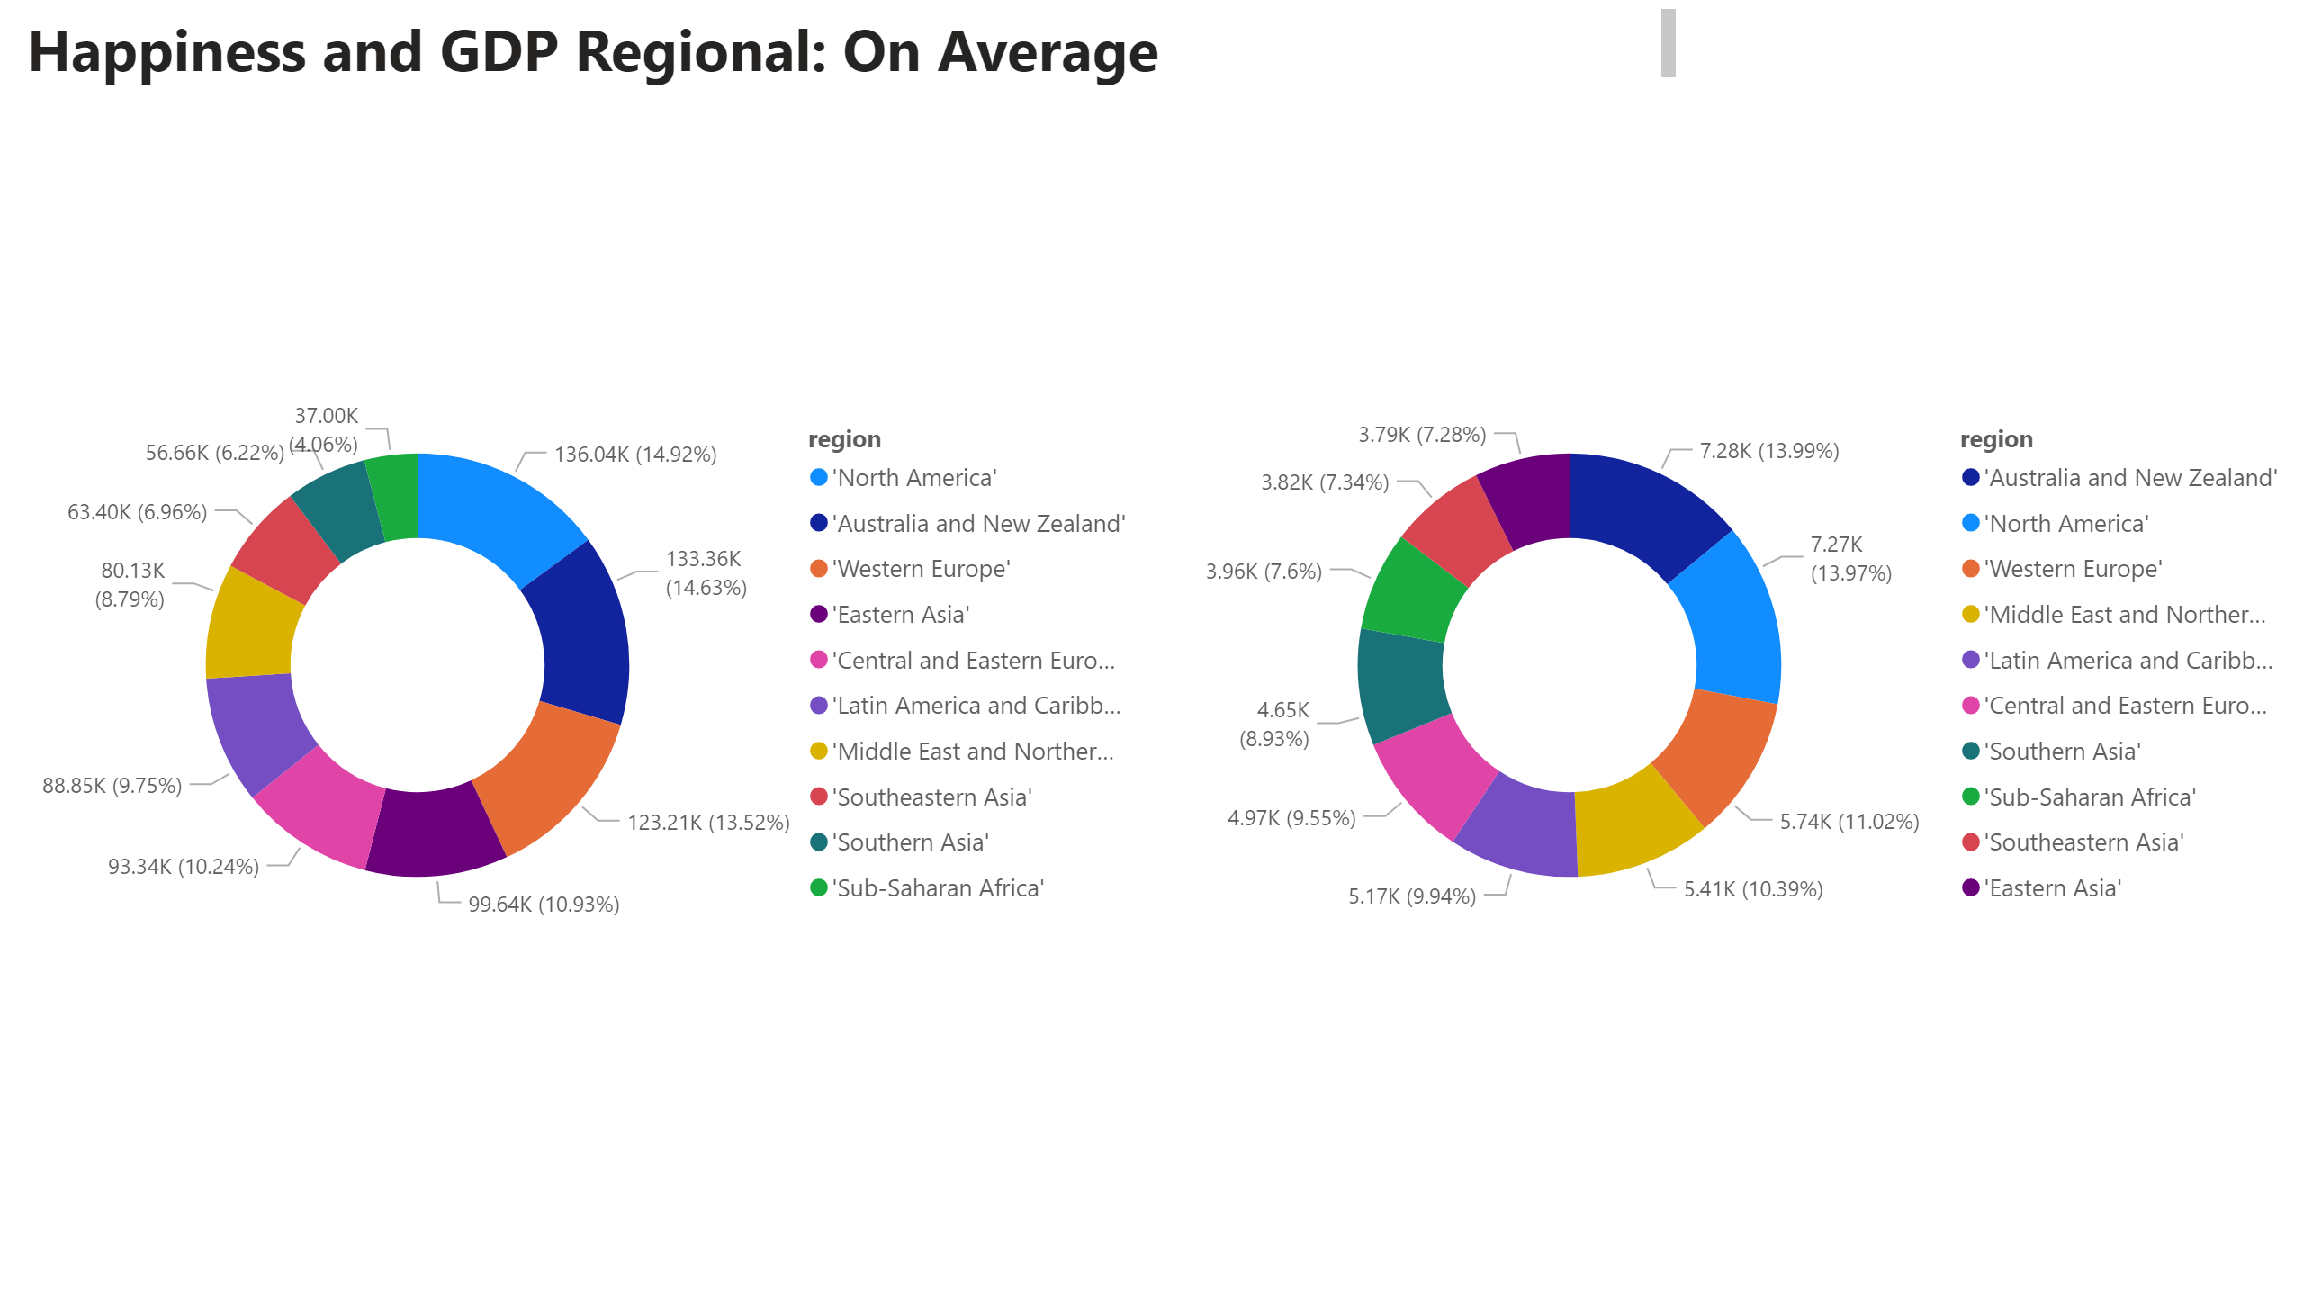
Rata-rata
Notes:
textbox
No alt text provided
donutChart
No alt text provided
donutChart
No alt text provided

Slide 4
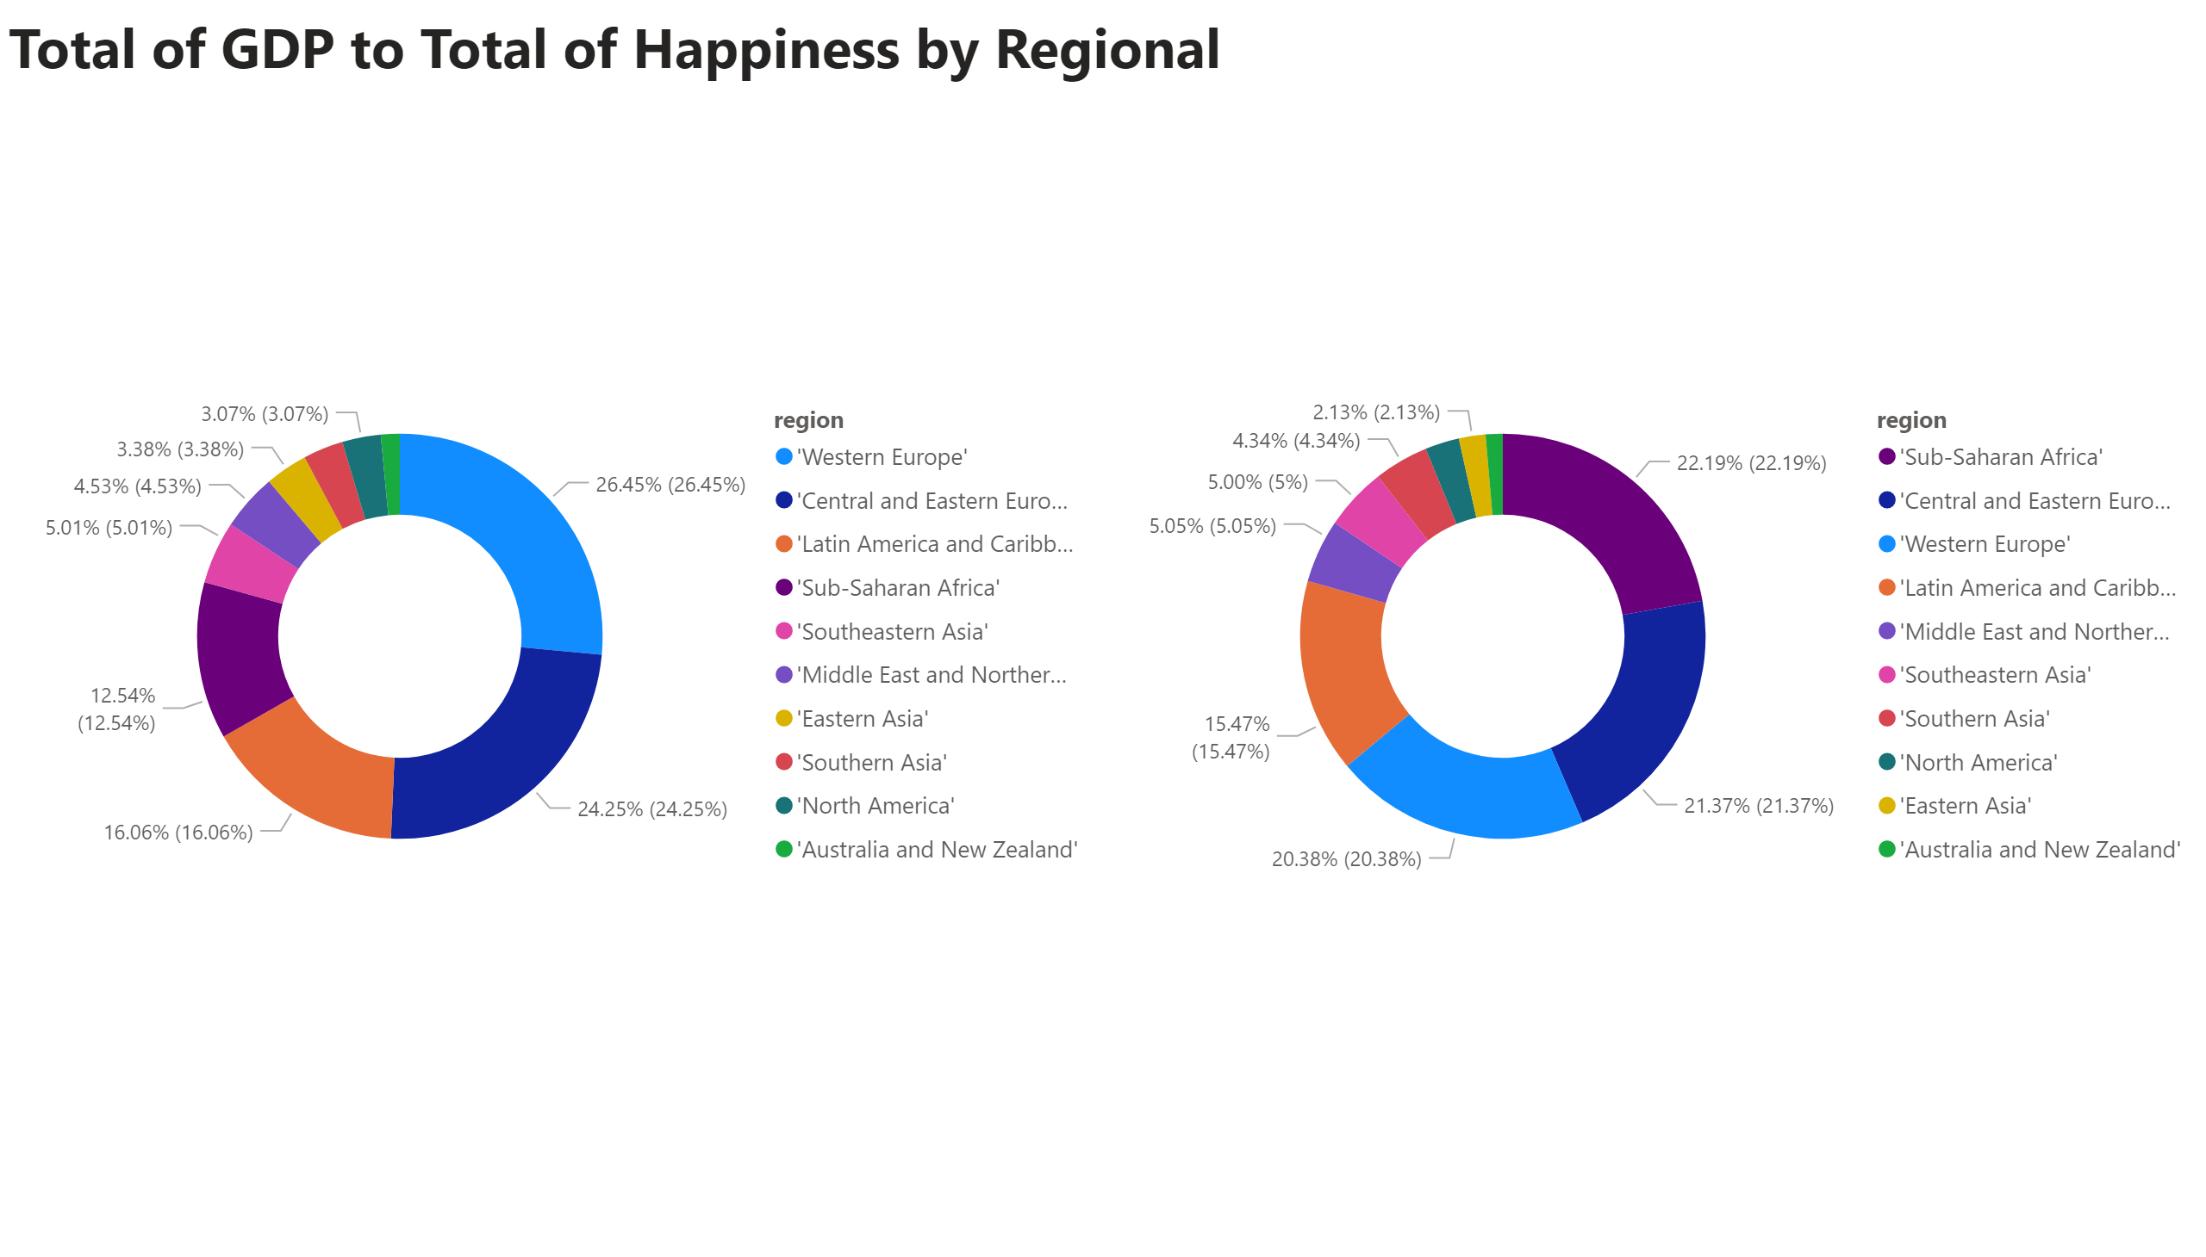
Total
Notes:
textbox
No alt text provided
donutChart
No alt text provided
donutChart
No alt text provided

Slide 5
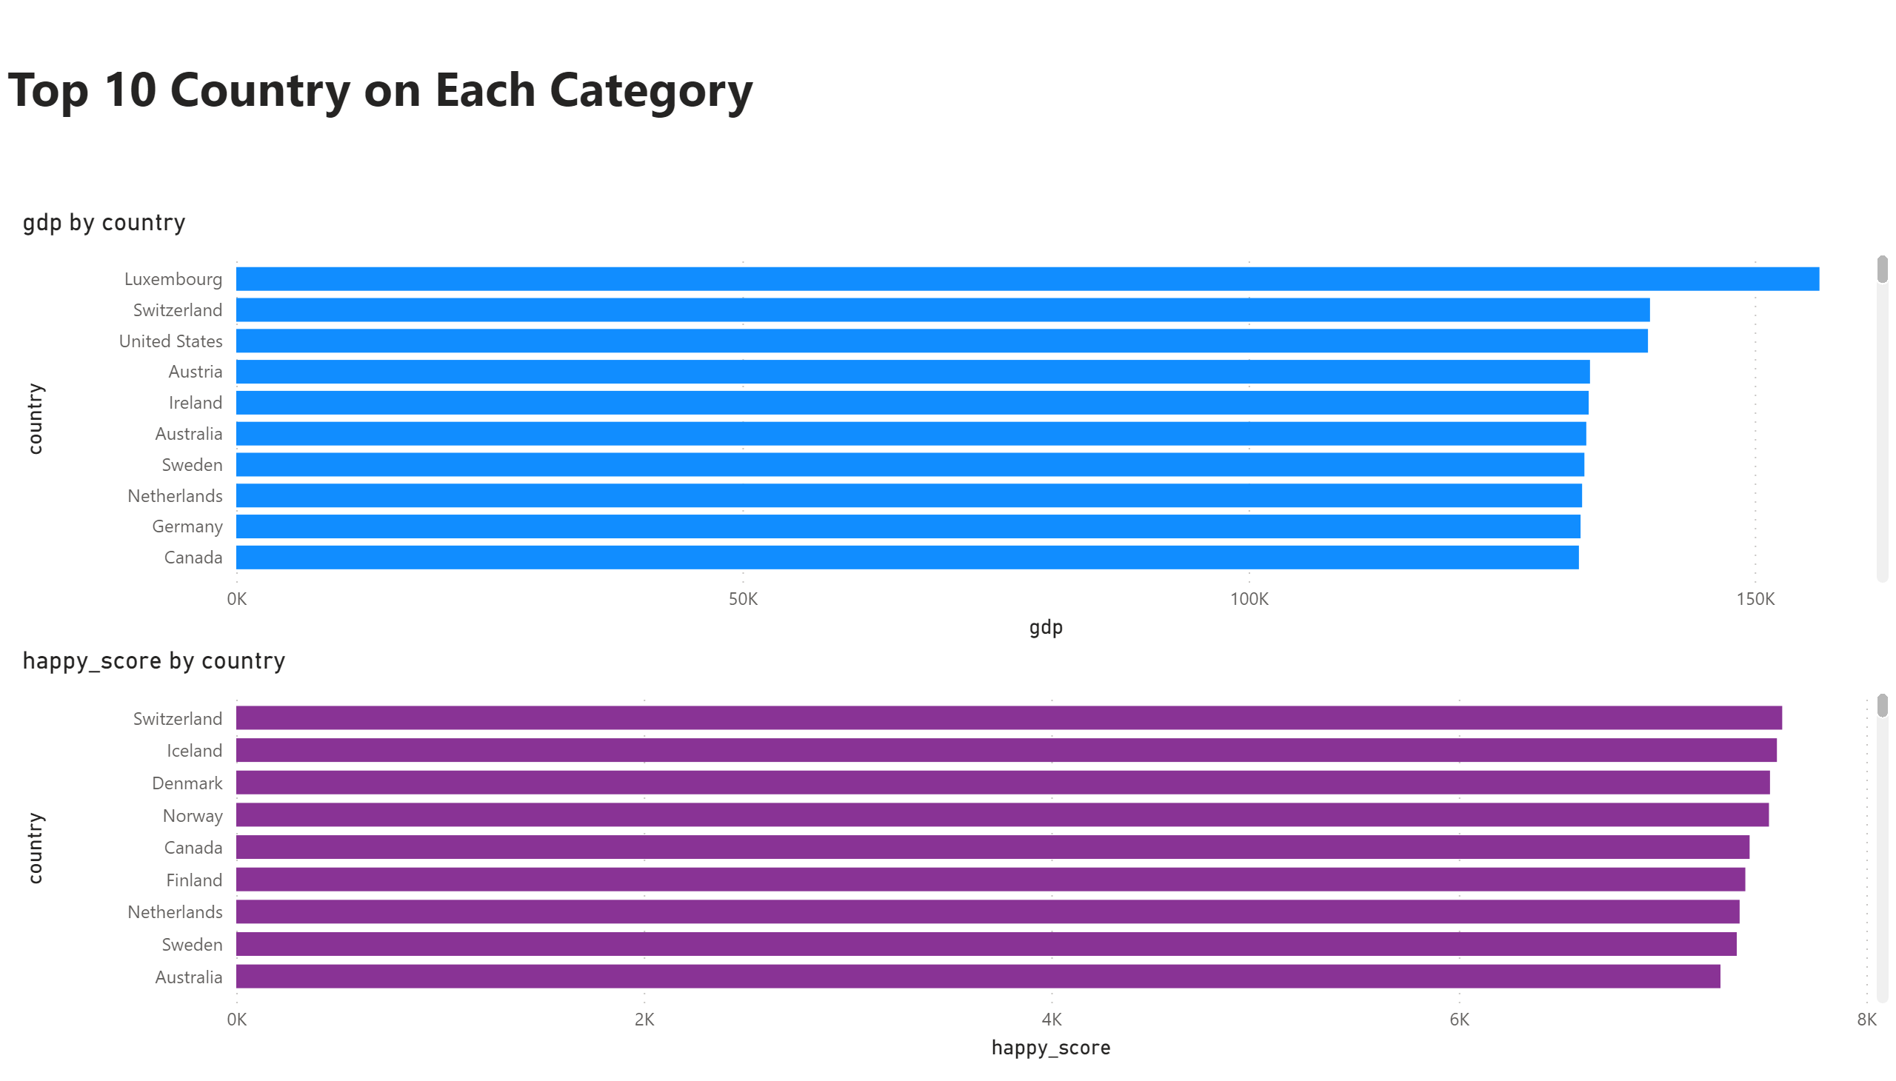
Top 10
Notes:
textbox
No alt text provided
clusteredBarChart
No alt text provided
clusteredBarChart
No alt text provided

